Slide 1

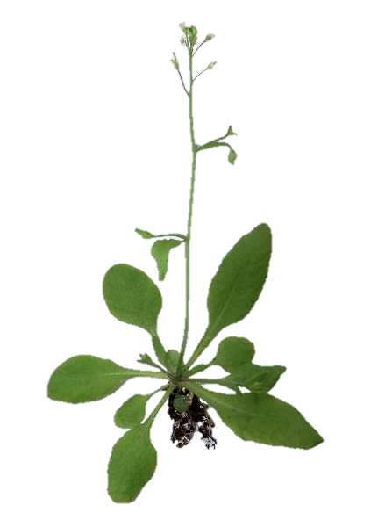

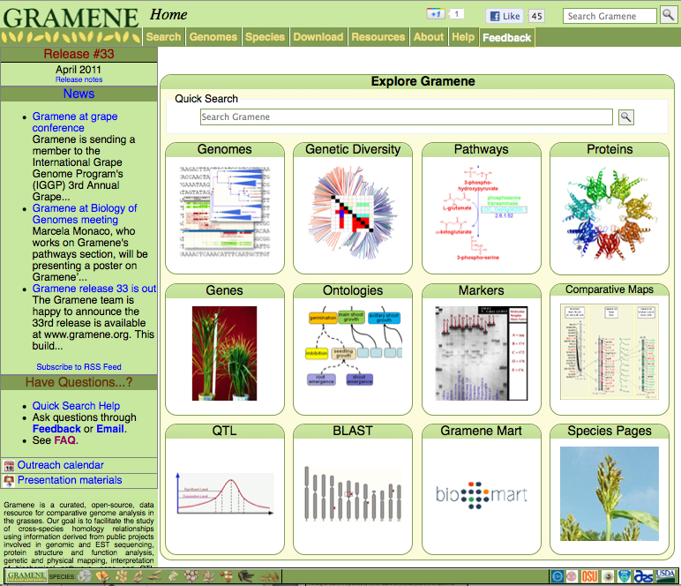
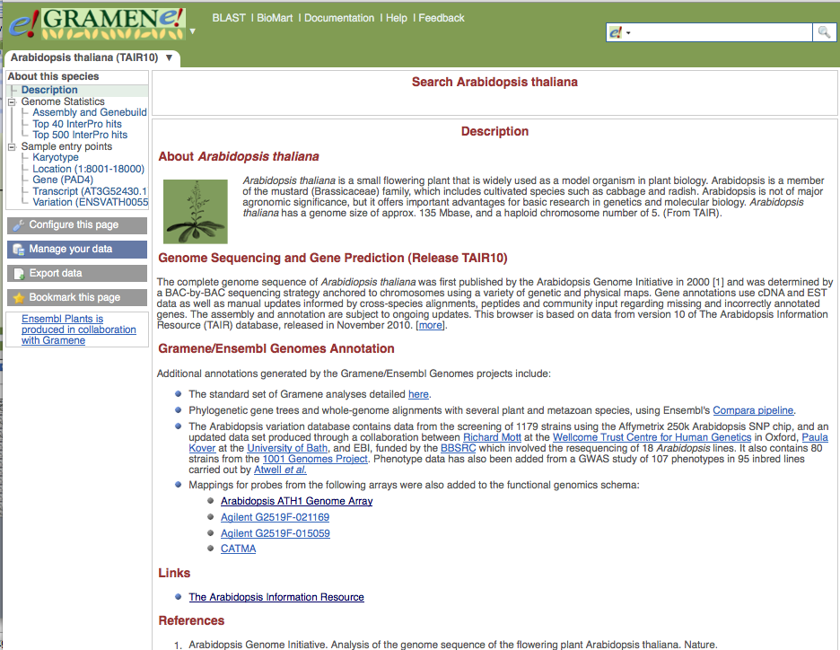
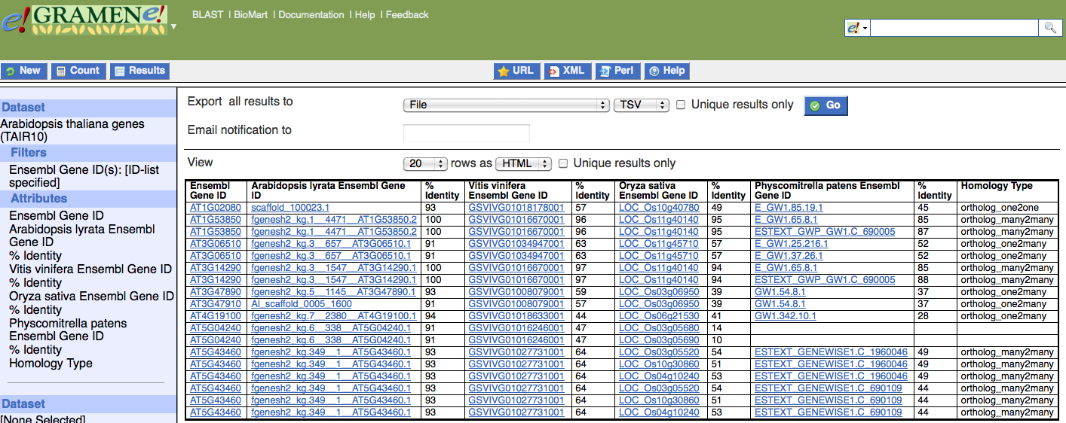
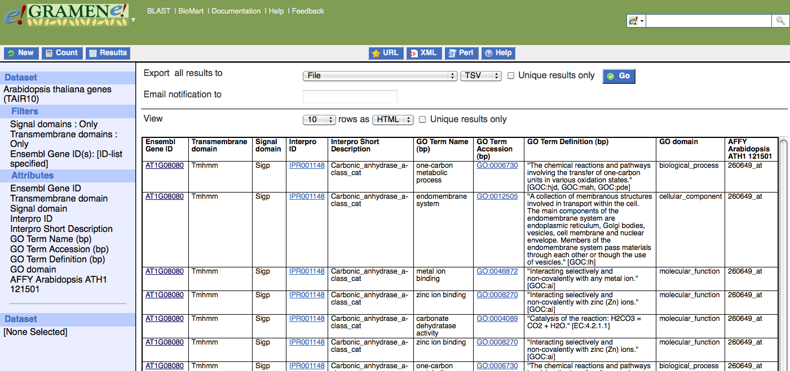
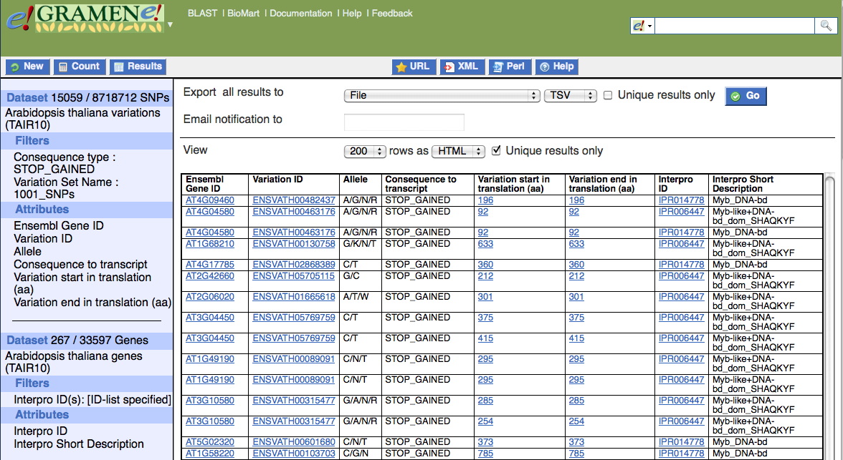
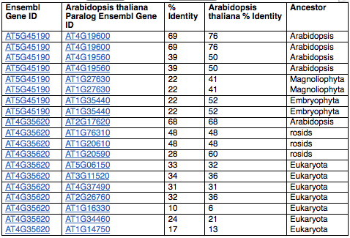

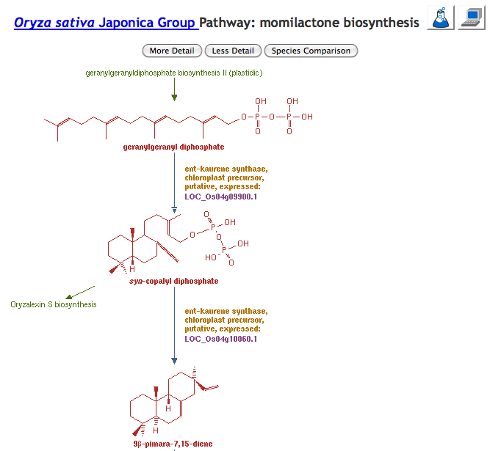
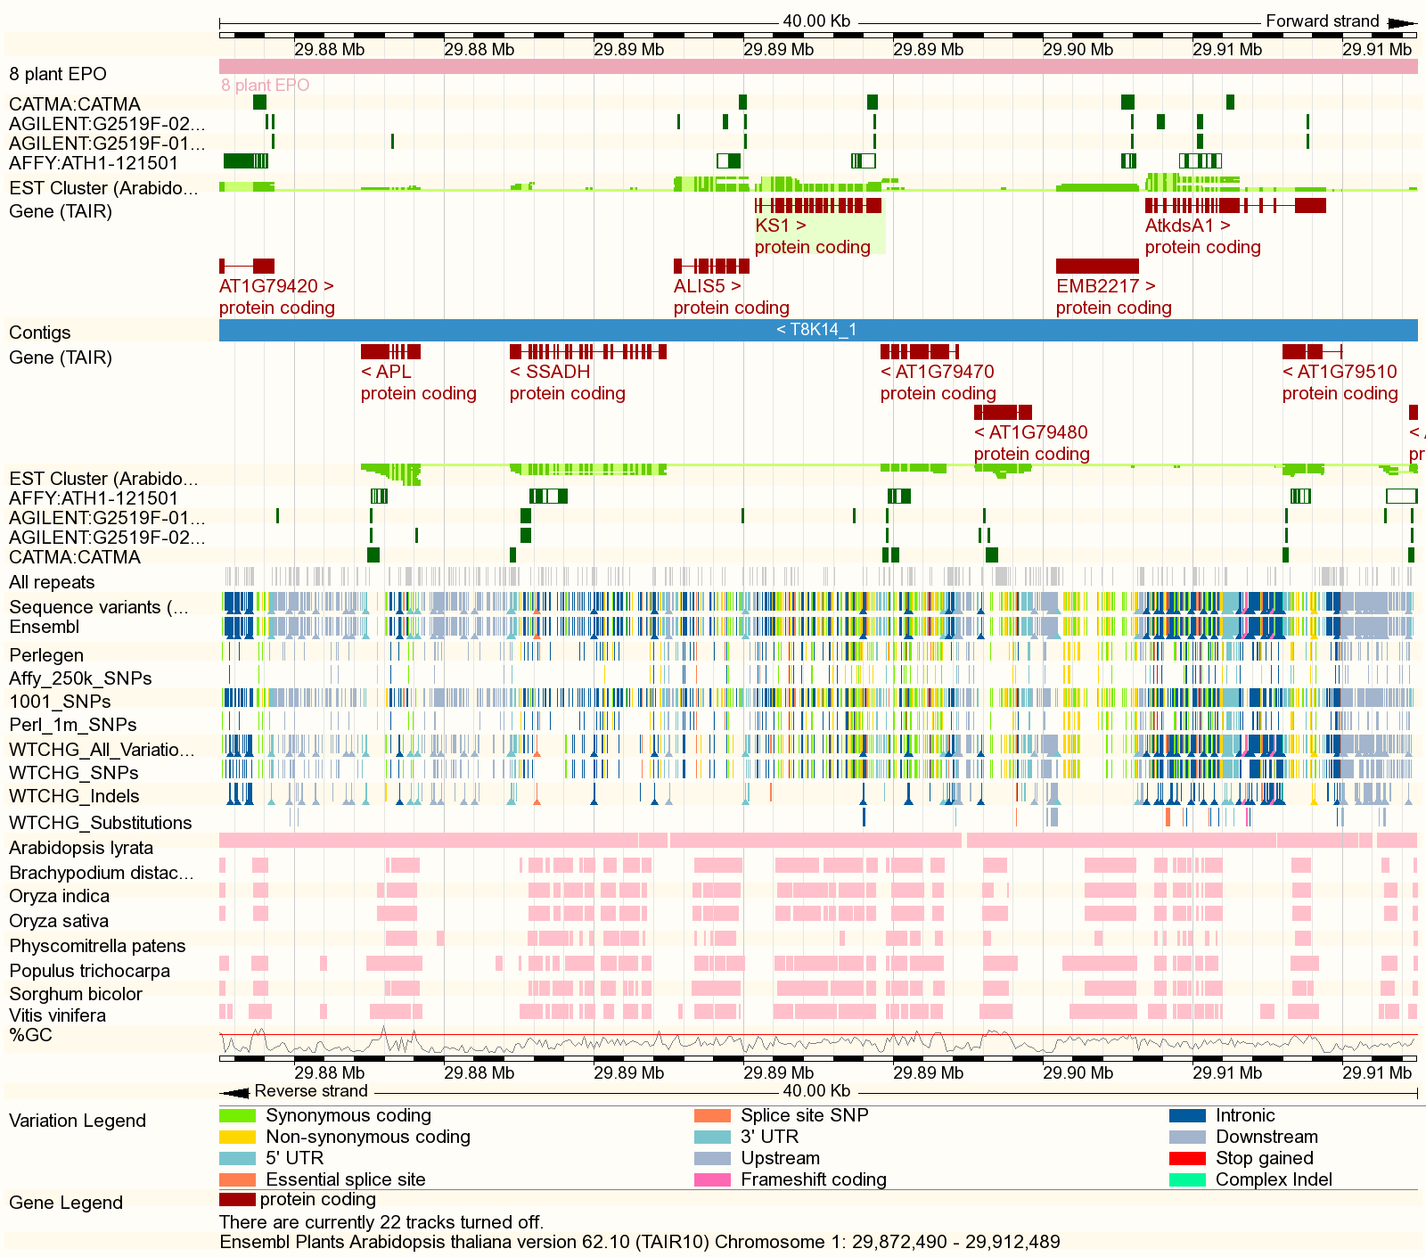
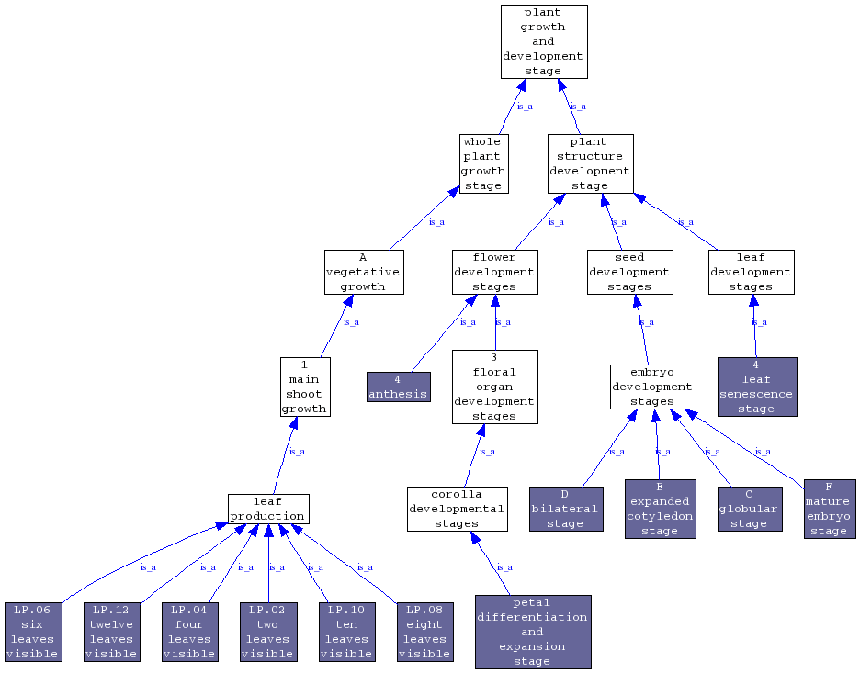
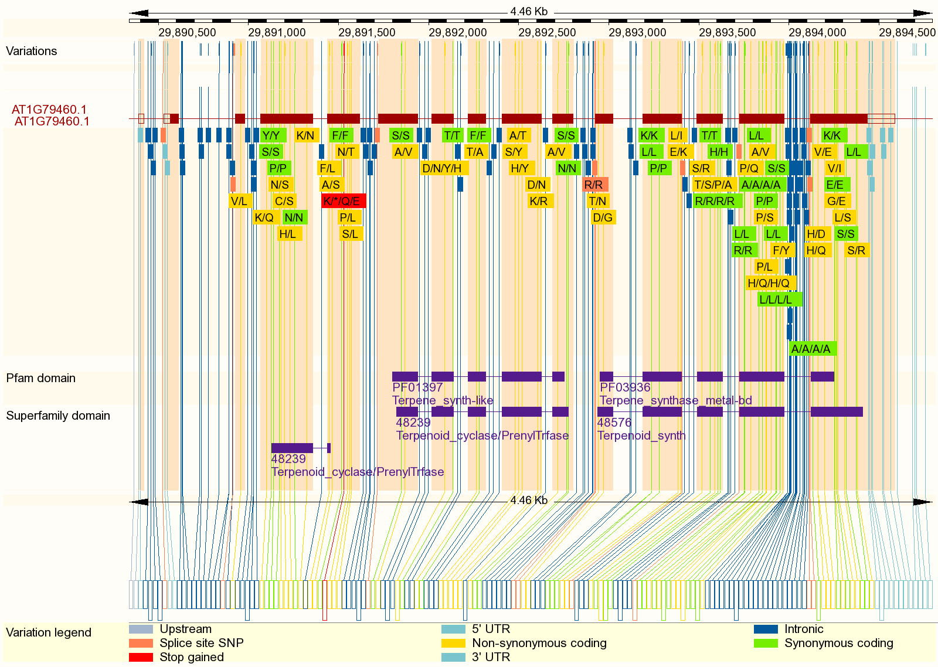
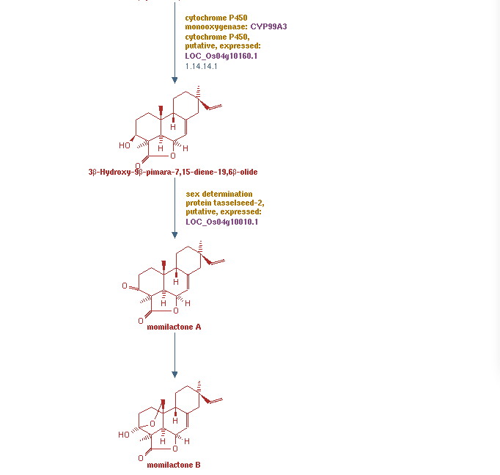
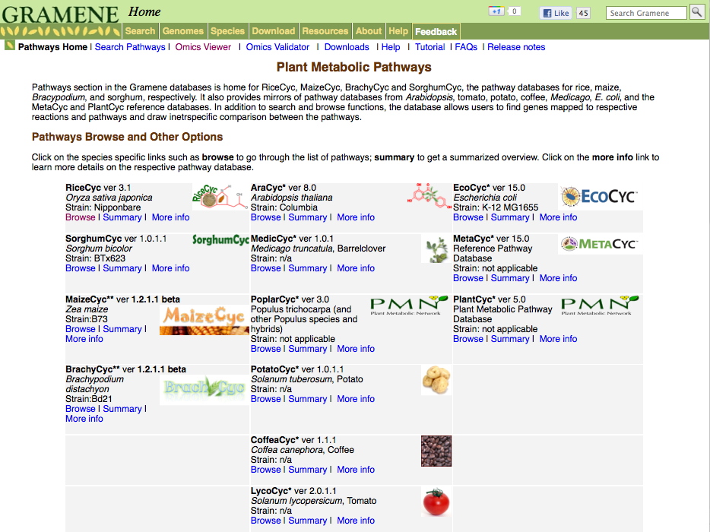
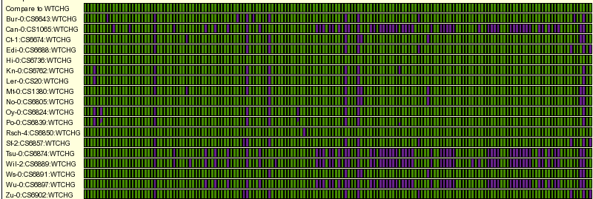
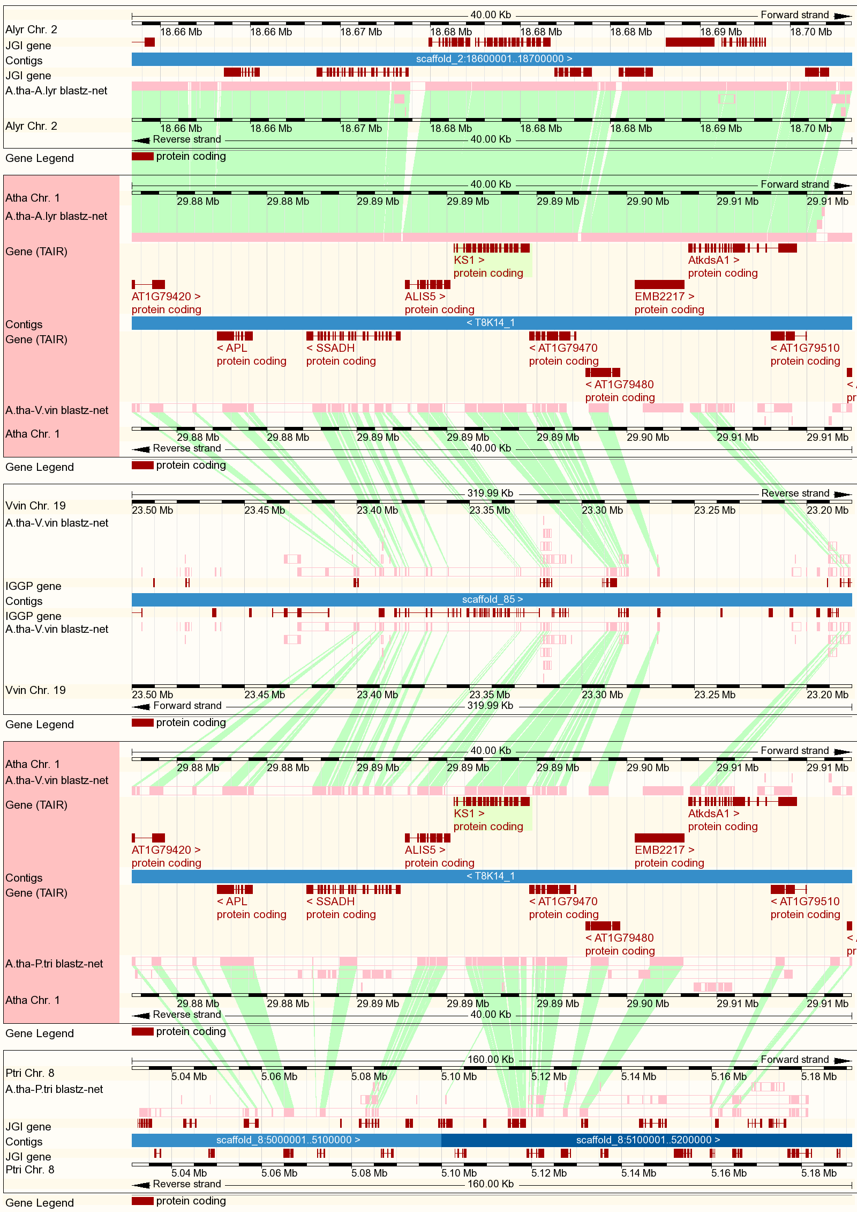
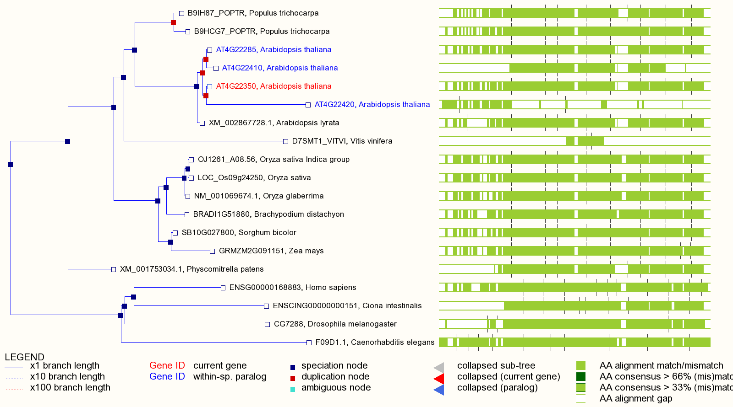
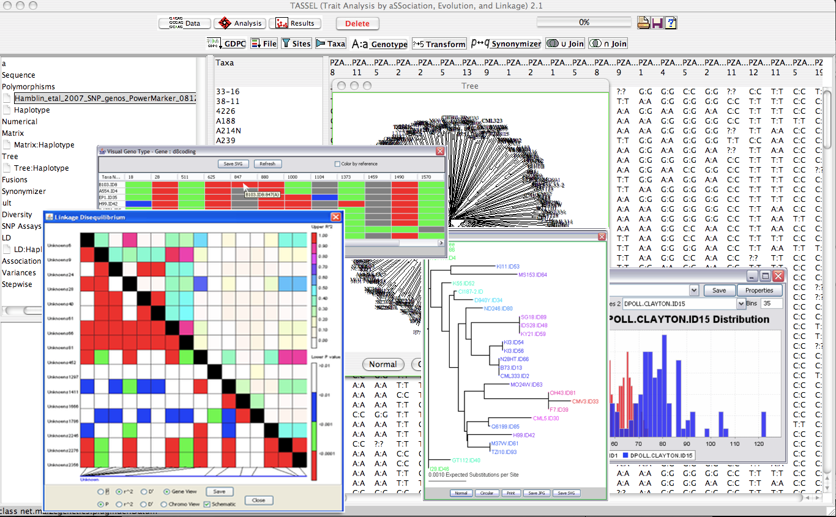
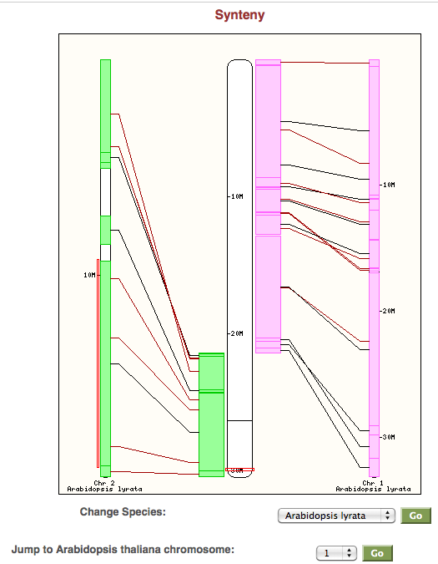
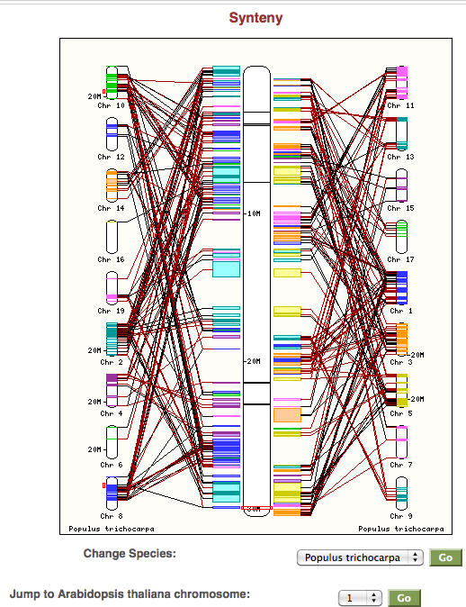
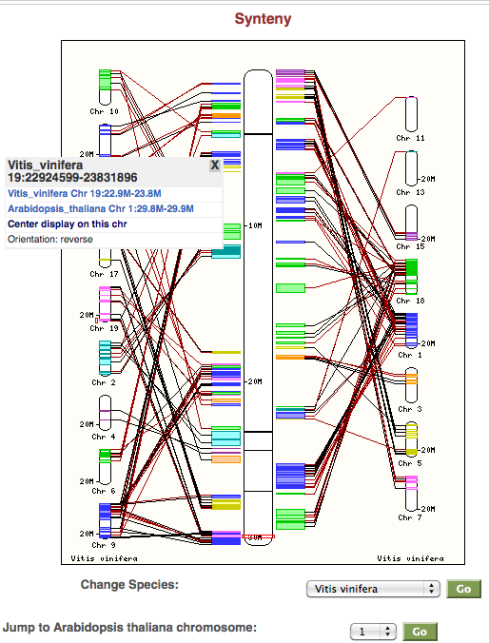
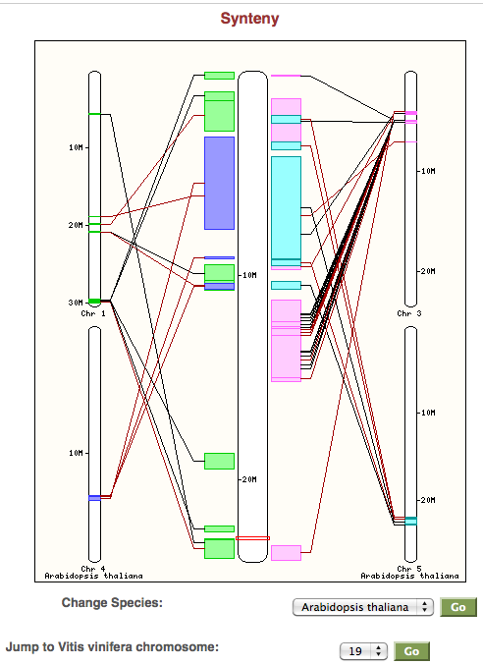
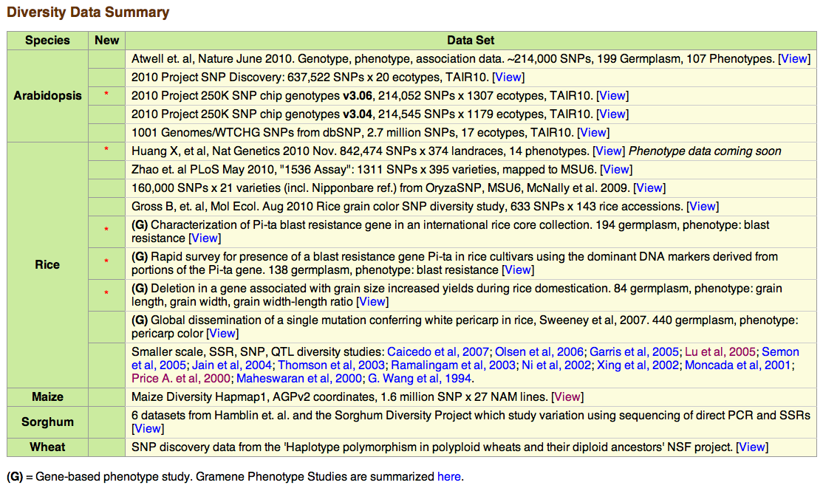
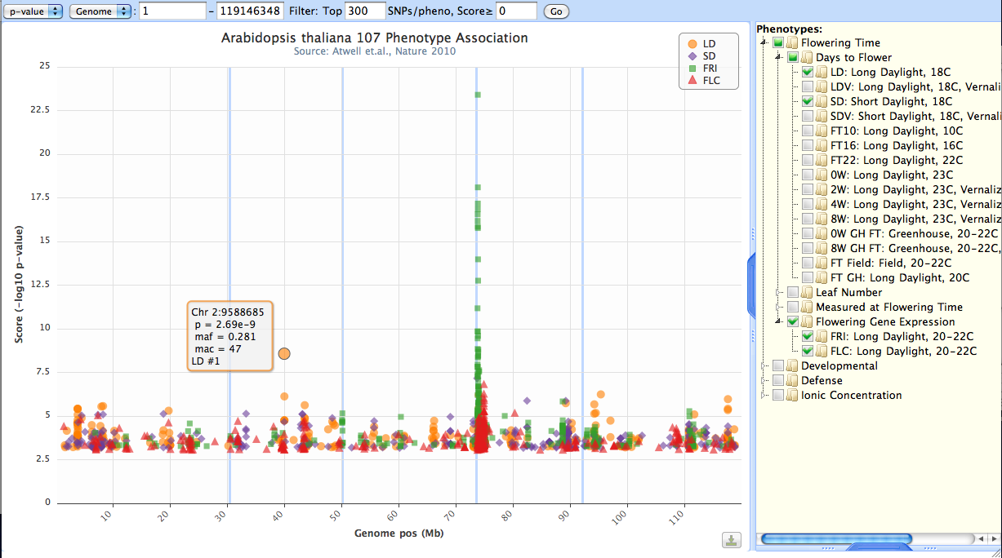










Gramene: It’s Not Just For Grasses Anymore
Joshua C. Stein ¹, Ed Buckler ^{2,3}, Terry Casstevens ⁴, Charles Chen ⁴, Genevieve DeClerck ⁴, Palitha Dharmawardhana ⁵, Pankaj Jaiswal ⁵, AS Karthikeyan ⁴, Marcela Monaco ¹, Susan R McCouch ⁴, Will Spooner ¹, Jim Thomason ¹, Sharon Wei ¹, Ken Youens-Clark ¹, Shiran Pasternak ^{1,} Doreen Ware ^{1,3}
¹Cold Spring Harbor Laboratory, Cold Spring Harbor, NY, USA; ²Institute for Genomic Diversity, Cornell University, Ithaca, NY, 14853, USA; ³USDA ARS NAA Robert W. Holley Center for Agriculture and Health, Cornell University, Ithaca, NY, 14853, USA; ⁴Department of Plant Breeding and Genetics, 240 Emerson Hall, Cornell University, Ithaca, NY, 14853, USA ; ⁵Dept of Botany and Plant Pathology, 3082 Cordley Hall, Oregon State University, Corvallis, OR, 97331, USA
http://pested.ifas.ufl.edu/newsletters/september2007/Arabidopsis.jpg
Integrating functional, genetic & comparative information for discovery and hypothesis based research
Home
Arabidopsis Entry Page
Custom queries and downloads
Export to Excel or text
Orthologs in lyrata, grape, poplar, rice, Brachypodium, sorghum maize, & moss
All transmembrane-targeted genes, showing InterPro domains, GO terms, and AFFY id’s
All Myb-domain genes with “STOP_GAINED” SNP allele in germplasm
Complete Genomes: Arabidopsis thaliana, Arabidopsis lyrata, grapevine, poplar, rice (3), Brachypodium, sorghum, & maize
Taxon of origin for paralog pairs of cyclin-domain genes that have an ortholog in Physcomitrella
Produced in collaboration w/
The Browser: Focus on Diversity
Functional Annotation:
Pathways & Ontologies
Millions of SNPs, thousands of ecotypes
View functional consequences within gene and protein domains
Genotypes displayed in graphical & tabular form
Order seed from ABRC via direct links to TAIR
Gene Ontology (GO)
Trait Ontology (TO)
Plant Ontology (PO)
Environment Ontology (OE)
Taxon Ontology (GR_tax)
Search across species
Link to Arabidopsis via orthology
Overlay experimental data in Omics viewer
AraCyc¹ pathway database mirror
Compare to pathways of rice², sorghum², maize², Brachypodium², Solanaceae³ (tomato, potato, pepper), coffee³, Medicago⁴, and poplar¹ to find homologs and enrich Arabidopsis pathway annotation
Overlay your gene expression (microarray, RNAseq), metabolomics, and proteomics data onto the pathway cellular overview to see pathway enrichment in your data
1 TAIR/PMN; 2 Gramene; 3 SGN; 4 Noble Foundation
Comparative & Phylogenomics
Population Genetics
Whole genome alignments vs 8 reference genomes (BLASTZ-CHAIN-NET)
Compara gene trees trace evolutionary histories in over 35,000 families
Ortholog & paralog classification
Taxon dating of duplication nodes
Interspecies browsing in Multi-species view and Synteny-view
TASSEL
Trait Analysis by aSSociation, Evolution, and Linkage
Calculate and view linkage disequilibrium and evolutionary patterns
Association analysis by generalized linear model and mixed linear model
Trees incorporate 4 eudicots, 6 grasses, plus human, Ciona, fly, worm, and yeast
Future Development
GWAS viewer to display Manhattan plots
Data standardization to capture fine-grained details of phenotype and experiment in a logical and consistent manner
Currently prototyping on the Atwell et al. 2010 study
Multi-species view: Aribidopsis lyrata, grapevine, and poplar in pairwise alignments with Arabidopsis thaliana
Chr 1 vs lyrata
vs poplar
vs grape
Navigate across duplications by centering on grape
Gramene is funded by the NSF award IOS:0703908 (Gramene: A Platform for Comparative Plant Genomics). Partial support comes from the USDA and USDA-ARS.
The Gramene Project was formed by collaboration between Cold Spring Harbor Laboratories, Oregon State University, and Cornell University.
Gramene collaborates with Ensembl, a joint project between EMBL-EBI and the Sanger Institute
Recent Publications:
Spooner W, et al. (2011) GrameneMart: The BioMart data portal for the Gramene project. Database (Oxford). In Press.
Jaiswal P. Gramene database: a hub for comparative plant genomics. Methods Mol Biol, 678:247-75.
Youens-Clark K, et al. (2010) Gramene database in 2010: updates and extensions. Nucleic Acids Research, 39 (suppl 1): D1085-D1094.
Ni J, et al. (2009) Gramene QTL database: development, content, and applications. Database (Oxford). 2009:bap005. Epub 2009 May 8.

